Slide 1
Quantum Error Correction on Shor’s Algorithm
By: Sachin Srikar

Slide 2
Objective
The objective of my research project is to reduce operational error associated with running quantum Fourier transformation (QFT) on Shor’s algorithm. The period, r, for Shor’s algorithm should be generate more and more consistently.

Slide 3
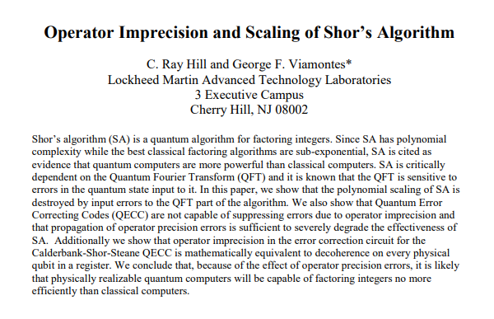
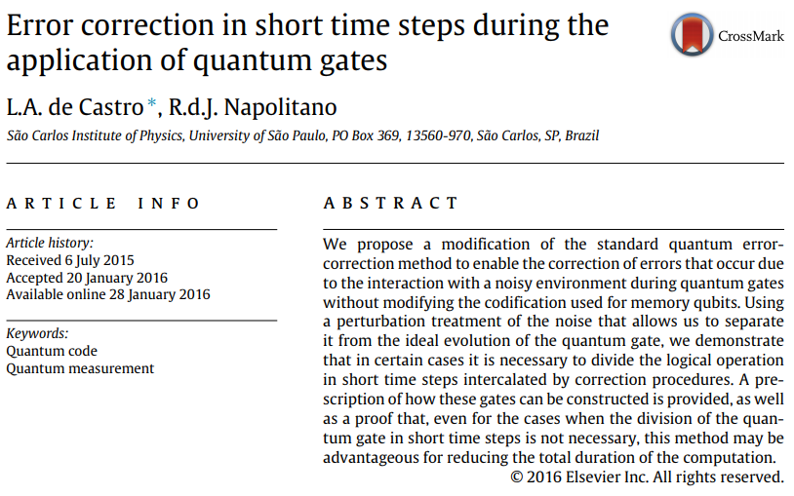
Previous and Current Research
Shor comes up with algorithm for factoring large numbers and calculation of discrete logarithms (Shor, 1994).
Research done on error correction for noisy quantum systems (Shor, 1995).
It is found that error correction cannot solve the problem of operator precision error, specifically associated with QFT (Hill and Viamontes, 2008).
A method of error correction during the application of quantum gates is proposed (de Castro and Napolitano, 2016).

Slide 4

Justification
Shor’s algorithm is used for factorization of large numbers. It has the potential to break modern encryption keys (RSA). The algorithm is projected to work on a quantum computer with minimal error. If the algorithm is error corrected, we could use it to revolutionize the field of cryptography. It could also be scaled up to factor larger numbers.

Slide 5
Description
There are scalable versions of Shor’s algorithm that have factored small numbers. I would apply different error correction codes to the algorithm, and find the error associated with each code. Ideally, the result should garner us the proper factors (periods).

Slide 6
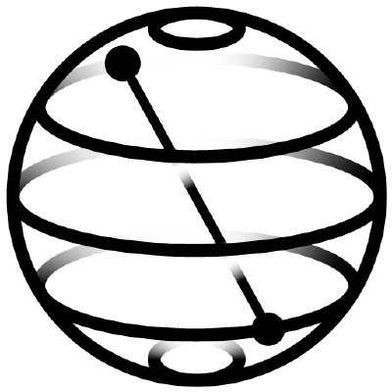
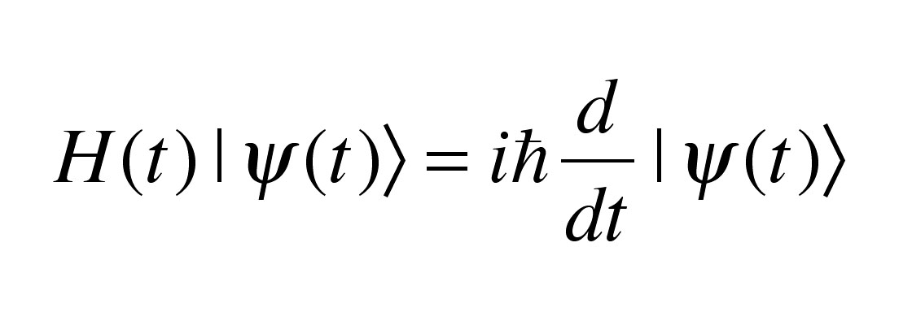
Limitations
A large amount of time will have to be spent learning linear algebra to supplement the understanding of my project.
Many available resources for quantum computing are already online, open source. Access to IBM quantum computers is possible through Qiskit, a Python framework for programming on quantum computers.

